Slide 1
Overview of In-Memory Database Management with SQL Server
Nick Doyle
Slide Deck: http://bit.ly/1kvWrR7

Slide 2
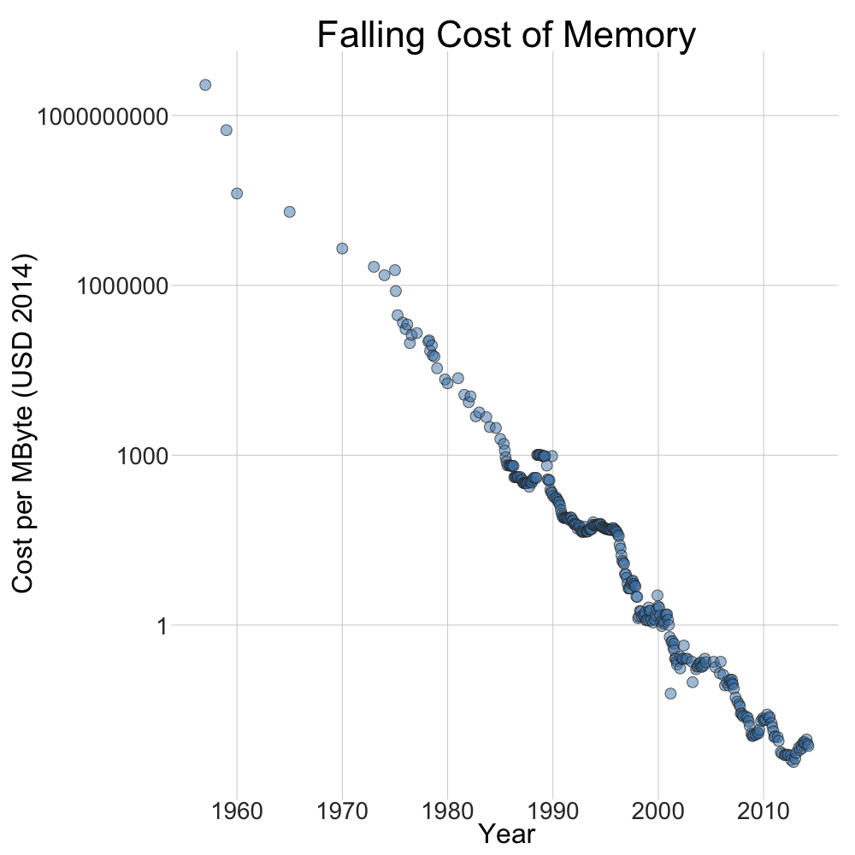
http://letstalkdata.com/2014/04/falling-cost-of-memory-1957-to-present/

Slide 3

About Me
Senior Software Engineer at Plex Systems
Data Junkie
Worked with every version of SQL Server since 2000
Other technical interests: Data Architecture, C#, ETL, Functional and Reactive Programming..
Email: nicholasdoyle@live.com

Slide 4
Expectations
Assuming a decent working knowledge of SQL Server engine
Overview of in-memory options for SQL Server
Shallow summary of internals
Demonstration of performance gains
Pros and cons
What to look out for
Equip you to spot potential use-cases
Offer functionality to customers - previously not feasible
Performance improvements

Slide 5
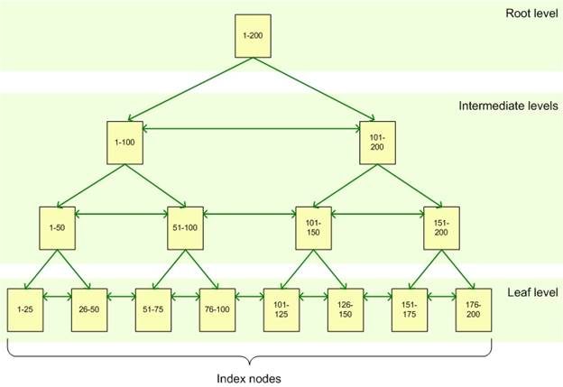
Review: B-Tree Index

Slide 6
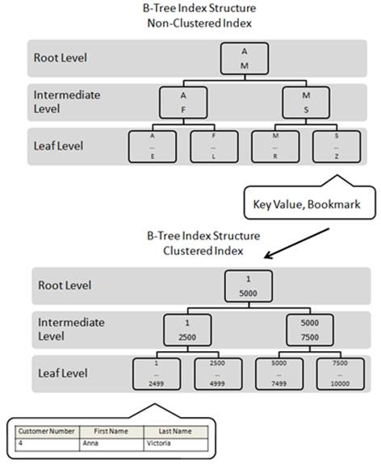
Review: Clustered vs Non-Clustered

Slide 7




Columnstore Storage
Data stored by column instead of by row
Row Column

Slide 8
Columnstore Index
Row groups usually contain about 1 million rows
Segments are compressed and stored separately as LOBs
Row Group
Column Segment
C1
C2
C3
C4
C5
C6

Slide 9
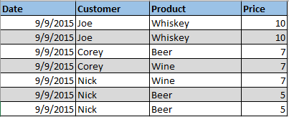


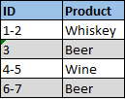

Columnstore Compression
Row
Column (run-length compression*)
More data fits in memory
Only need to read necessary columns
*Other compression schemes can additionally be used, this is an example

Slide 10
Batch Execution Mode
Operators performed on batches of roughly 900 rows, instead of one row at a time
Limited operator support – enhanced in 2014 and 2016
Currently only works with columnstores

Slide 11
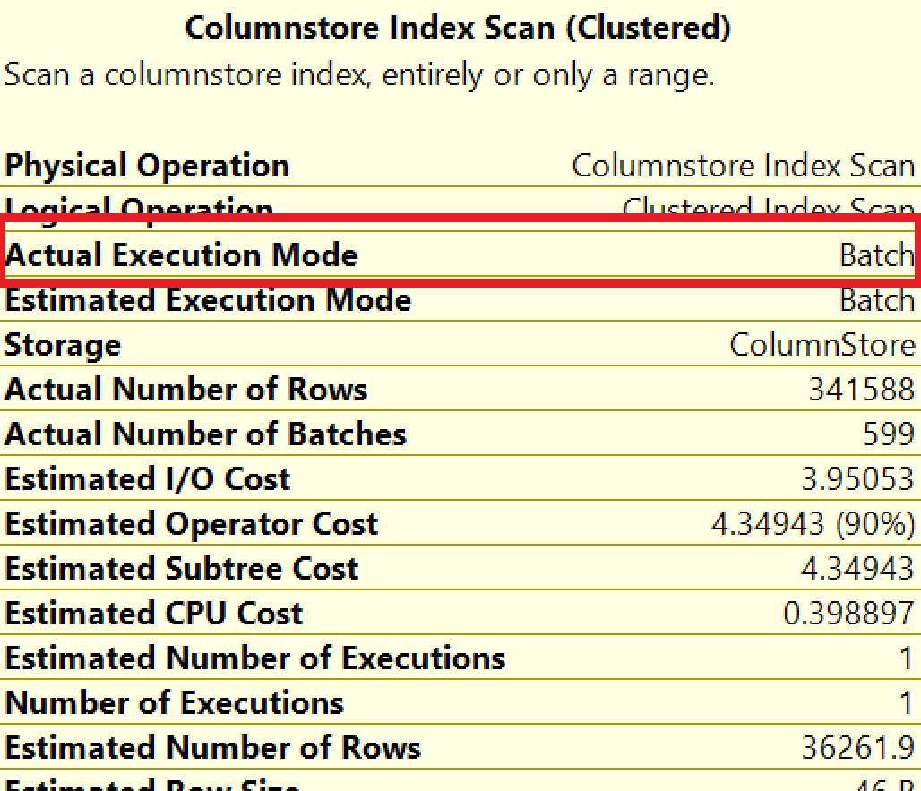
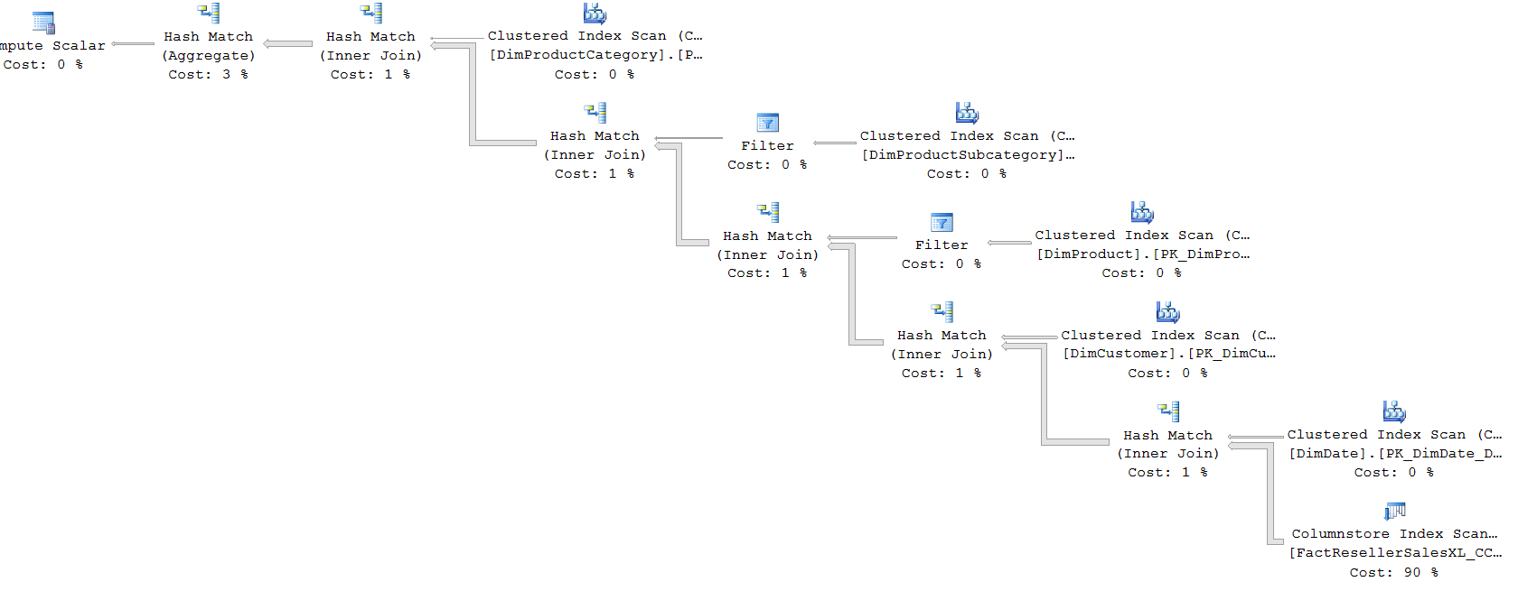
Batch Execution Mode

Slide 12

Cost Of Goods Sold
Manufacturing costs broken down by
Labor
Production
Machine
Materials
etc

Slide 13
Columnstore Demo

Slide 14
Columnstore – Sweet Spot
Large analytical workloads over a subset of columns

Slide 15
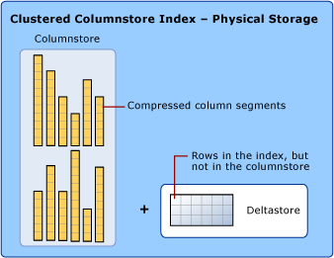
Columnstore downsides
Updates are expensive
Incremental functionality
Maintenance
Index rebuild (offline) to reclaim space from deleted rows
Row group alignment
Some supposed to be addressed in SQL Server 2016
Enterprise edition or Azure premium only

Slide 16
Advice / Learnings
Use batching where feasible
Cases where you can see extreme transaction log use: Deleting 0.8GB data using >16GB of tlog
Batching options: bcp, SSIS, C# SqlBulkCopy, manual looping, ..
Memory footprint
Large tables can consume a lot of memory when queried
Partitioning
Batch execution mode doesn’t work with MAXDOP 1 until SQL 2016

Slide 17
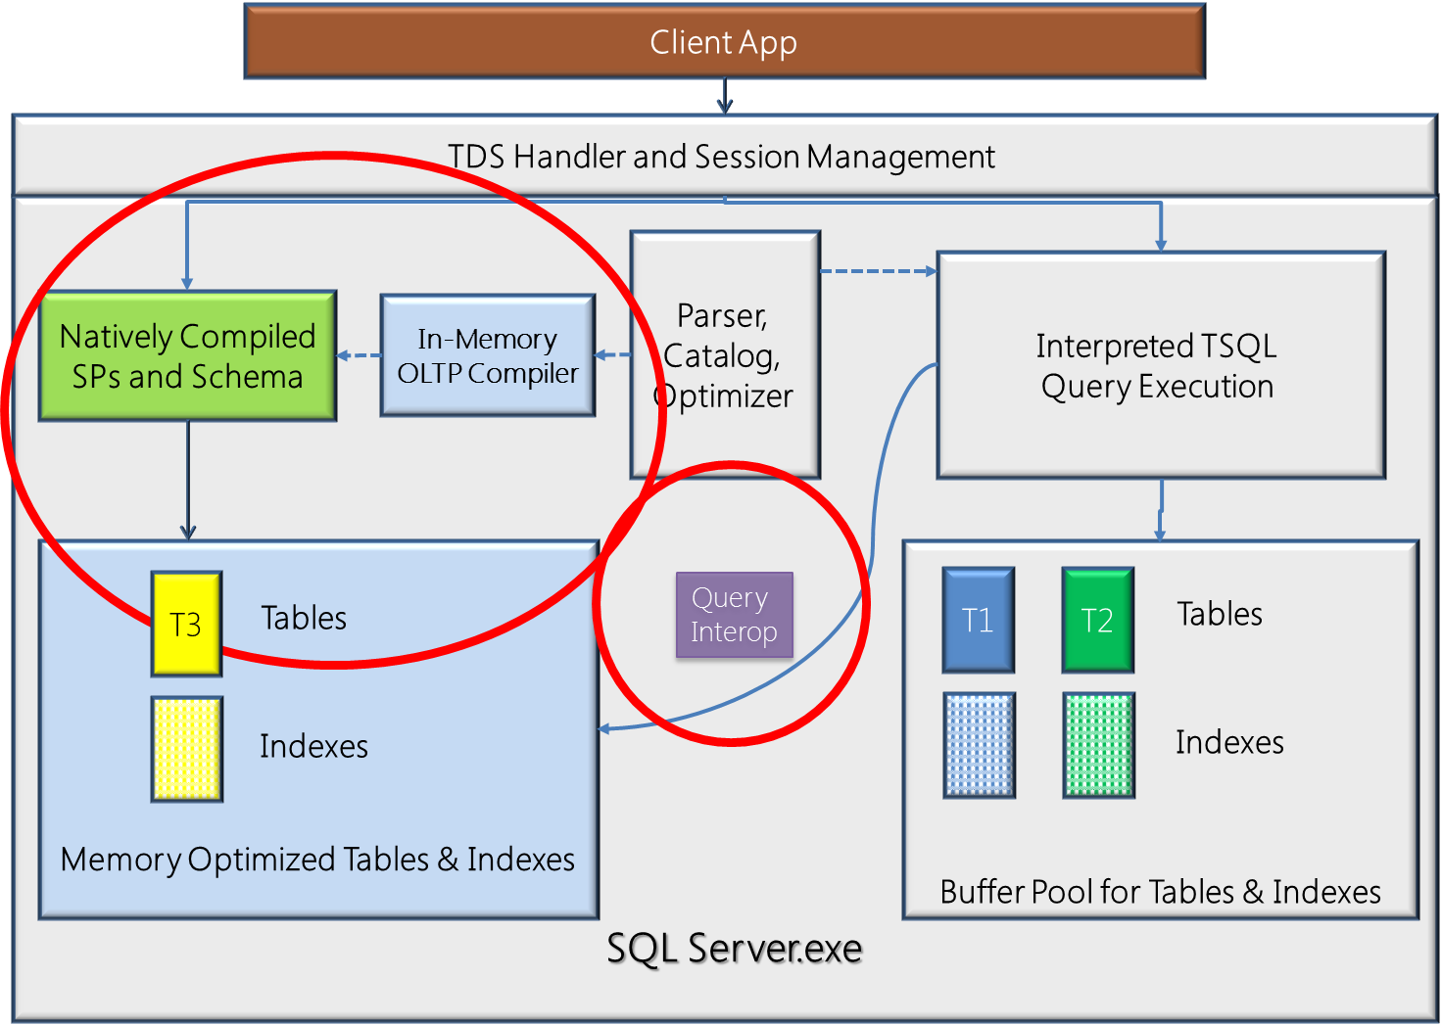
In-Memory OLTP

Slide 18
In-Memory OLTP - Concurrency
Pessimistic vs Optimistic Concurrency
MVCC – Multiversion Concurrency Control
Snapshot isolation default
Immutable data structures

Slide 19

In-Memory OLTP – MVCC Example

Slide 20

In-Memory OLTP – MVCC Example

Slide 21
In-Memory OLTP – Logging and Durability
Logging
Parallel
Batching
Logs persisted only at commit
Indexes not persisted
Durability options

Slide 22
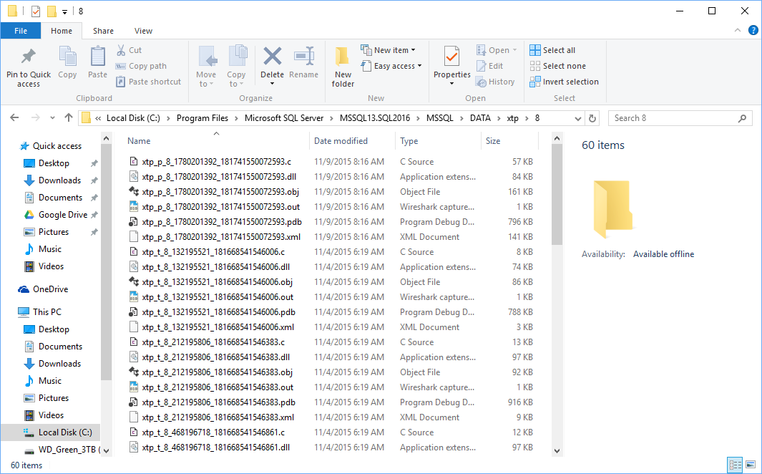
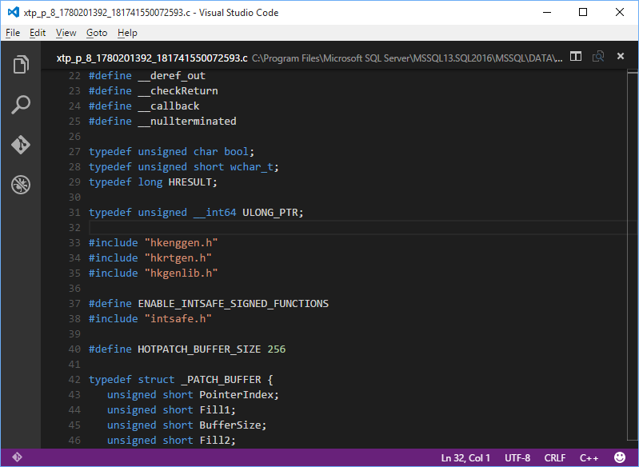
In-Memory OLTP – Native Compilation
Tables and stored procedures
Generated C Code
Natively compiled to a DLL

Slide 23
In-Memory OLTP Demo

Slide 25
In-Memory OLTP – Use-Cases
Suitable
Not Suitable
High-volume OLTP
ELT (data staging)
Bottlenecks
Lock or latch contention
I/O
Logging
CPU
OLAP
Memory constraints
Inability to make changes
Inability to deal with limitations
Reliance on traditional locking behavior

Slide 26
In-Memory OLTP - Warnings
Table data must fit in memory
Do not rely on dynamic memory allocation in virtual environments
Pre-allocate sufficient memory or the database could get stuck in recovery
Hash and range indexes only
Pre-allocate hash buckets for hash index (must get approximately correct: 1-2 buckets per key value)
Cross-container transaction isolation levels
Optimistic concurrency conflicts – retry
Usage Limitations
Very severe in SQL 2014
Native sproc limitations
Cannot join memory-optimized table to disk-based table
No temp table usage
Enterprise edition or Azure premium only

Slide 27
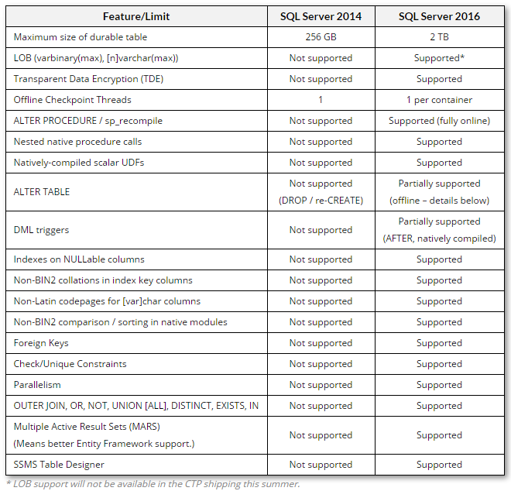

Slide 28
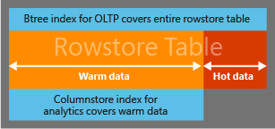
Operational Analytics
SQL Server 2016
HTAP – Hybrid Transactional/Analytical Processing

Slide 29
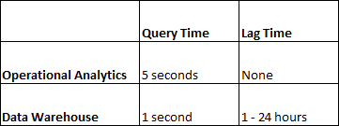
Operational Analytics – Real Time
Hypothetical scenario
Operational Analytics compared to Data Warehouse

Slide 30
Operational Analytics Demo

Slide 31
Considerations with Azure
Scaling
Scale to Premium and use ColumnStore for month-end reporting?
Scale to Premium and use In-Memory OLTP for seasonal surge?
Commoditized compute
ColumnStore and In-Memory OLTP are significantly more relevant

Slide 32
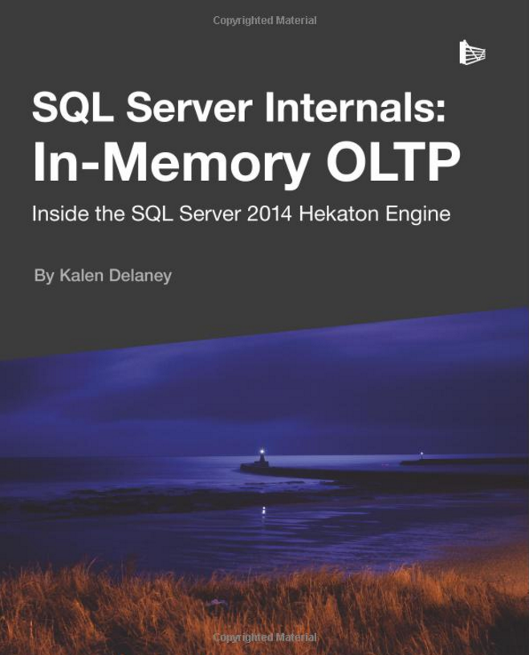
Additional Info
In-Memory OLTP
MS Research Whitepaper
In-Memory OLTP Internals
Free from Redgate
Columnar
The Impact of Columnar In-Memory Databases on Enterprise Systems
MOOC: In-Memory Database Management (theory)
Enhancements to SQL Server Column Stores
Columnstore Indexes: Niko Neugebauer
Get started with In-Memory (Preview) in SQL Database

